Slide 1

CA22123 EU-MACE:
Core Group monthly update GP3 #4
Virtual
10/02/2026

Slide 2
Hello!
Today’ meeting is recorded!

Slide 3
0. welcome
Preparing MC and WS
  Logistics
  Tentative Agenda
  MC discussion points
    MC decisions
    Training school
  WS organization
Updates from tasks
  ERASMUS+ discussion meeting
  Legacy Lab
  Young EU-MACE/Expert & MAP list
AOB

Slide 4
MC 1 & WorkShop in preparation

Slide 5
Tentative Agenda
EU-MACE MC1 meeting &
Joint workshop (EERA-AMPEA&E3S):
Sustainability in next generation energy materials and technologies
When: February 23-25, 2026
Where: Maison Irène & Frédéric Joliot Curie, Brussels (and online)
Format: Hybrid (F2F: WS speakers, WG and Task leaders, organizers + few listeners; online: everyone else
Recall:
Purpose: Create synergy and initiate collaborations between materials scientists and sustainability experts (including social science field)
Organization: HEU 2026-2027 CL4 & CL5 calls were used to structure the topic
Presentations: Research ideas on energy materials research and sustainability assessment (needs and expertise propositions)
Registeration: 20 presentation interests, 40 listeners
To non MC members: Please register to WS (as online listeners only) to receive invitation

Slide 6
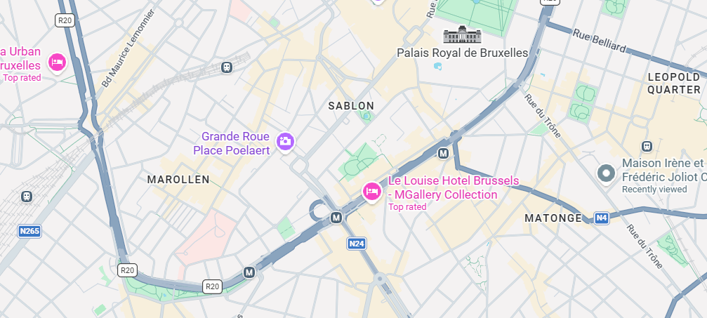
MC meeting & workshop: logistics
Feb 23-24-25 at Maison Irène & Frédéric Joliot Curie, Brussels – L.O. = EERA (GHI)
  MC meeting hybrid (mostly online) ➔ 25 MC members still have not replied on e-COST!! PLEASE DO!
  Lunch break ➔ must eat outside
  Metro Trone = closest (8-10 min)
  100 r du Trone
  From Brussels Midi, line 2 & 6
  Enter building and ask
  Arrival time
    MC meeting 8:30 AM ~
    WS 1:30 pm ~
    Check your invitation
F2F attendees – Remember COST Rules for reimbursement
  https://www.cost.eu/uploads/2025/11/COST-TRR-Rules-2025-2026.pdf
  And the FULL COST Rules (link in the pdf)
M: Trone
M: Namur
Brussels-Midi

Slide 7
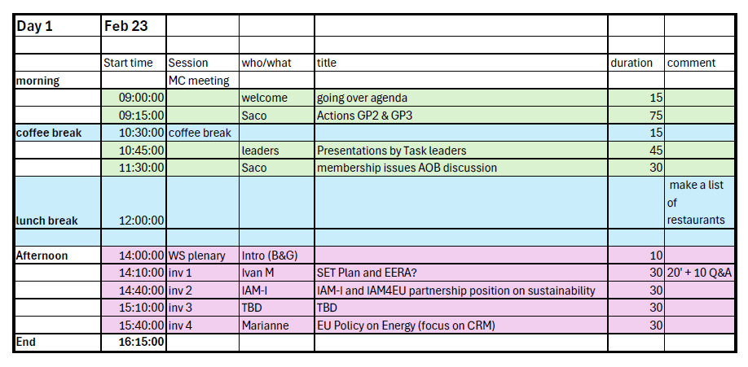
Day1

Slide 8
MC 1 discussion points

Slide 9
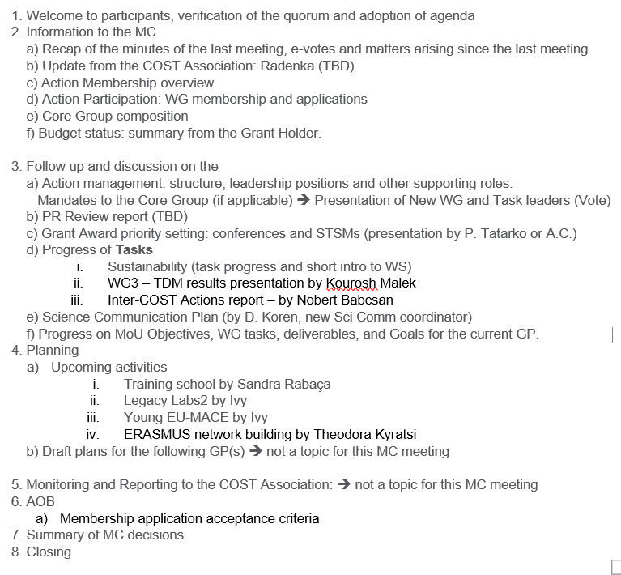
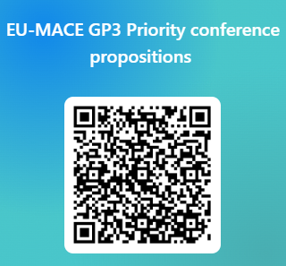
MC meeting agenda
Standard Format
Not many votes
Intervention by task leaders (5 – 10 minutes each)
Priority conferences!
  Must align with the MAIN objectives of EU-MACE
https://forms.office.com/Pages/ResponsePage.aspx?id=9xZkbOgxIEWCTMuTP4OQuXsjyL-l515MkDTrXz9gtT5UNkU4S0xTMVk2Q0Y3WUI1SjlKUVFNSEMySy4u

Slide 10

Joint workshop – « sustainability »
https://forms.office.com/Pages/ResponsePage.aspx?id=9xZkbOgxIEWCTMuTP4OQua30uxW7CP5Ki2iESeIBm99UNVFaOEZKSTRNT09LSEVWNUFaTjVXVUU1QS4u

Slide 11
WS starts on Day1 at 2pm
Workshop Plenary session with invited speakers:
Topics covered:
SET-Plan (new developments)
About EERA (what is it and how to join)
IAM-I focus (energy sector, IAM4EU partnership in HEU programme
EU Energy Policy trends
Sustainability in energy materials research

Slide 12
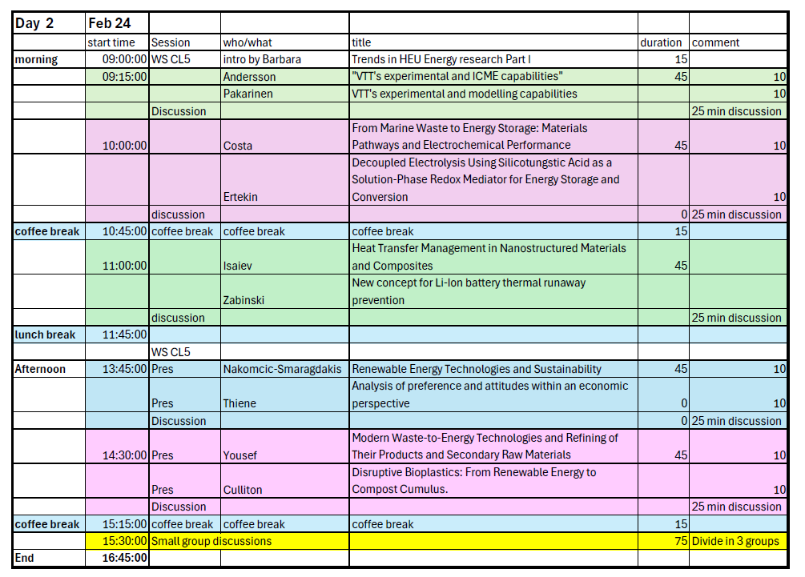
Day 2
Format
Short Presentations & Long discussions :
Facilitator presents trends of EU research through HEU promgrammes
1-3 presentations are limited to 10-12 minutes each, followed by 25-30 minute discussions for exchanging ideas
Breakout session is foreseen at the end of the day

Slide 13
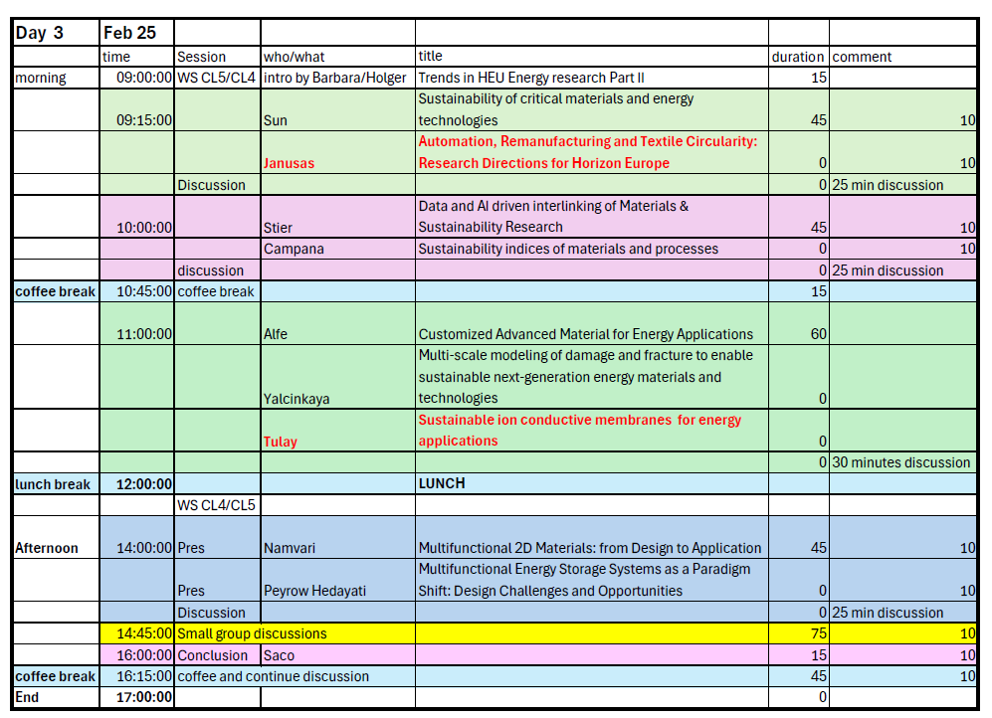
Day 3
Format
Short Presentations & Long discussions :
Same as Day 2
+ WS conclusion/way forward

Slide 14
Updates from tasks

Slide 15
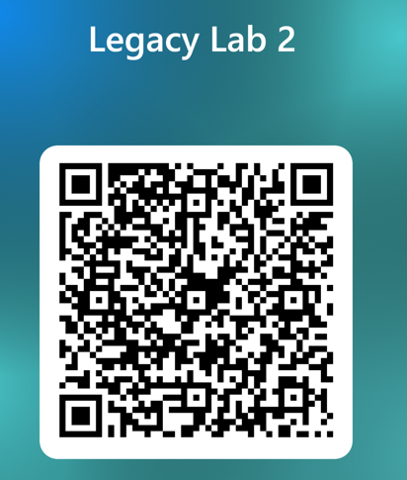
AccelMAPS/LegacyLabs/Erasmus/Young-EUMACE…
In-depth and detailed updates will be given during the MC meeting!
AcceLMAPs
Application opened ~20/01/2026 and open until Feb 28
Link via EU-MACE events’ page - https://eu-mace.eu/event/5862:training-school-2026-accelmaps-accelerating-energy-materials-development-from-legacy-labs-to-material-acceleration-platforms.html
22 scholarships (travel 600€ and 160/day allowance)
Apply today!!
LegacyLabs2
First meeting done!
Leaders = Ivy Tsang (PL) & Max Wolf (AT)
Still possible to join: https://forms.office.com/Pages/ResponsePage.aspx?id=AbEFPv7G5UeC4cakELuVwCgJibv2FtVEiG3gZhT3YqlURVBYWTRZME5DWlJVOU9YQ01RUEcwQktRMS4u

Slide 16
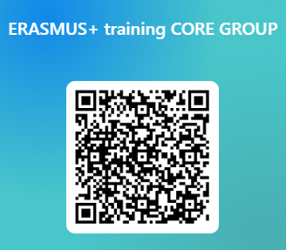
Task update cont’d
ERASMUS
First meeting next week! (10 ppl signed up
Still possible to join: https://forms.office.com/Pages/ResponsePage.aspx?id=9xZkbOgxIEWCTMuTP4OQuXsjyL-l515MkDTrXz9gtT5UMjVCNUNROVkyTlRKM0dHRTlFWDhRWVc2RS4u
Young EU-MACE seminar series
2 speaker candidates
Will re-start on March 10
Want to propose a student/post-doc from your lab? Contact Ivy!!
ChainMap upgrade
Periodic Review reviewer examined ChainMap
Will organize a meeting with Kourosh, Iosif, Monica, Saco & Bogdan ➔ have not done!!! Sorry….
Willing to contribute? Email Saco

Slide 17
AOB
Open discussion
Questions??
NEXT monthly update meetings: Second Tuesday at 3pm
Feb 10
March 10
April 14
May 12
See you all at MC meeting and Workshop! Don’t forget to register today!!!!
https://forms.office.com/Pages/ResponsePage.aspx?id=9xZkbOgxIEWCTMuTP4OQua30uxW7CP5Ki2iESeIBm99UNVFaOEZKSTRNT09LSEVWNUFaTjVXVUU1QS4u

